Slide 1
Proposed Tentative Handbook Amendment Kiley Ranch North Planned Development

Slide 2
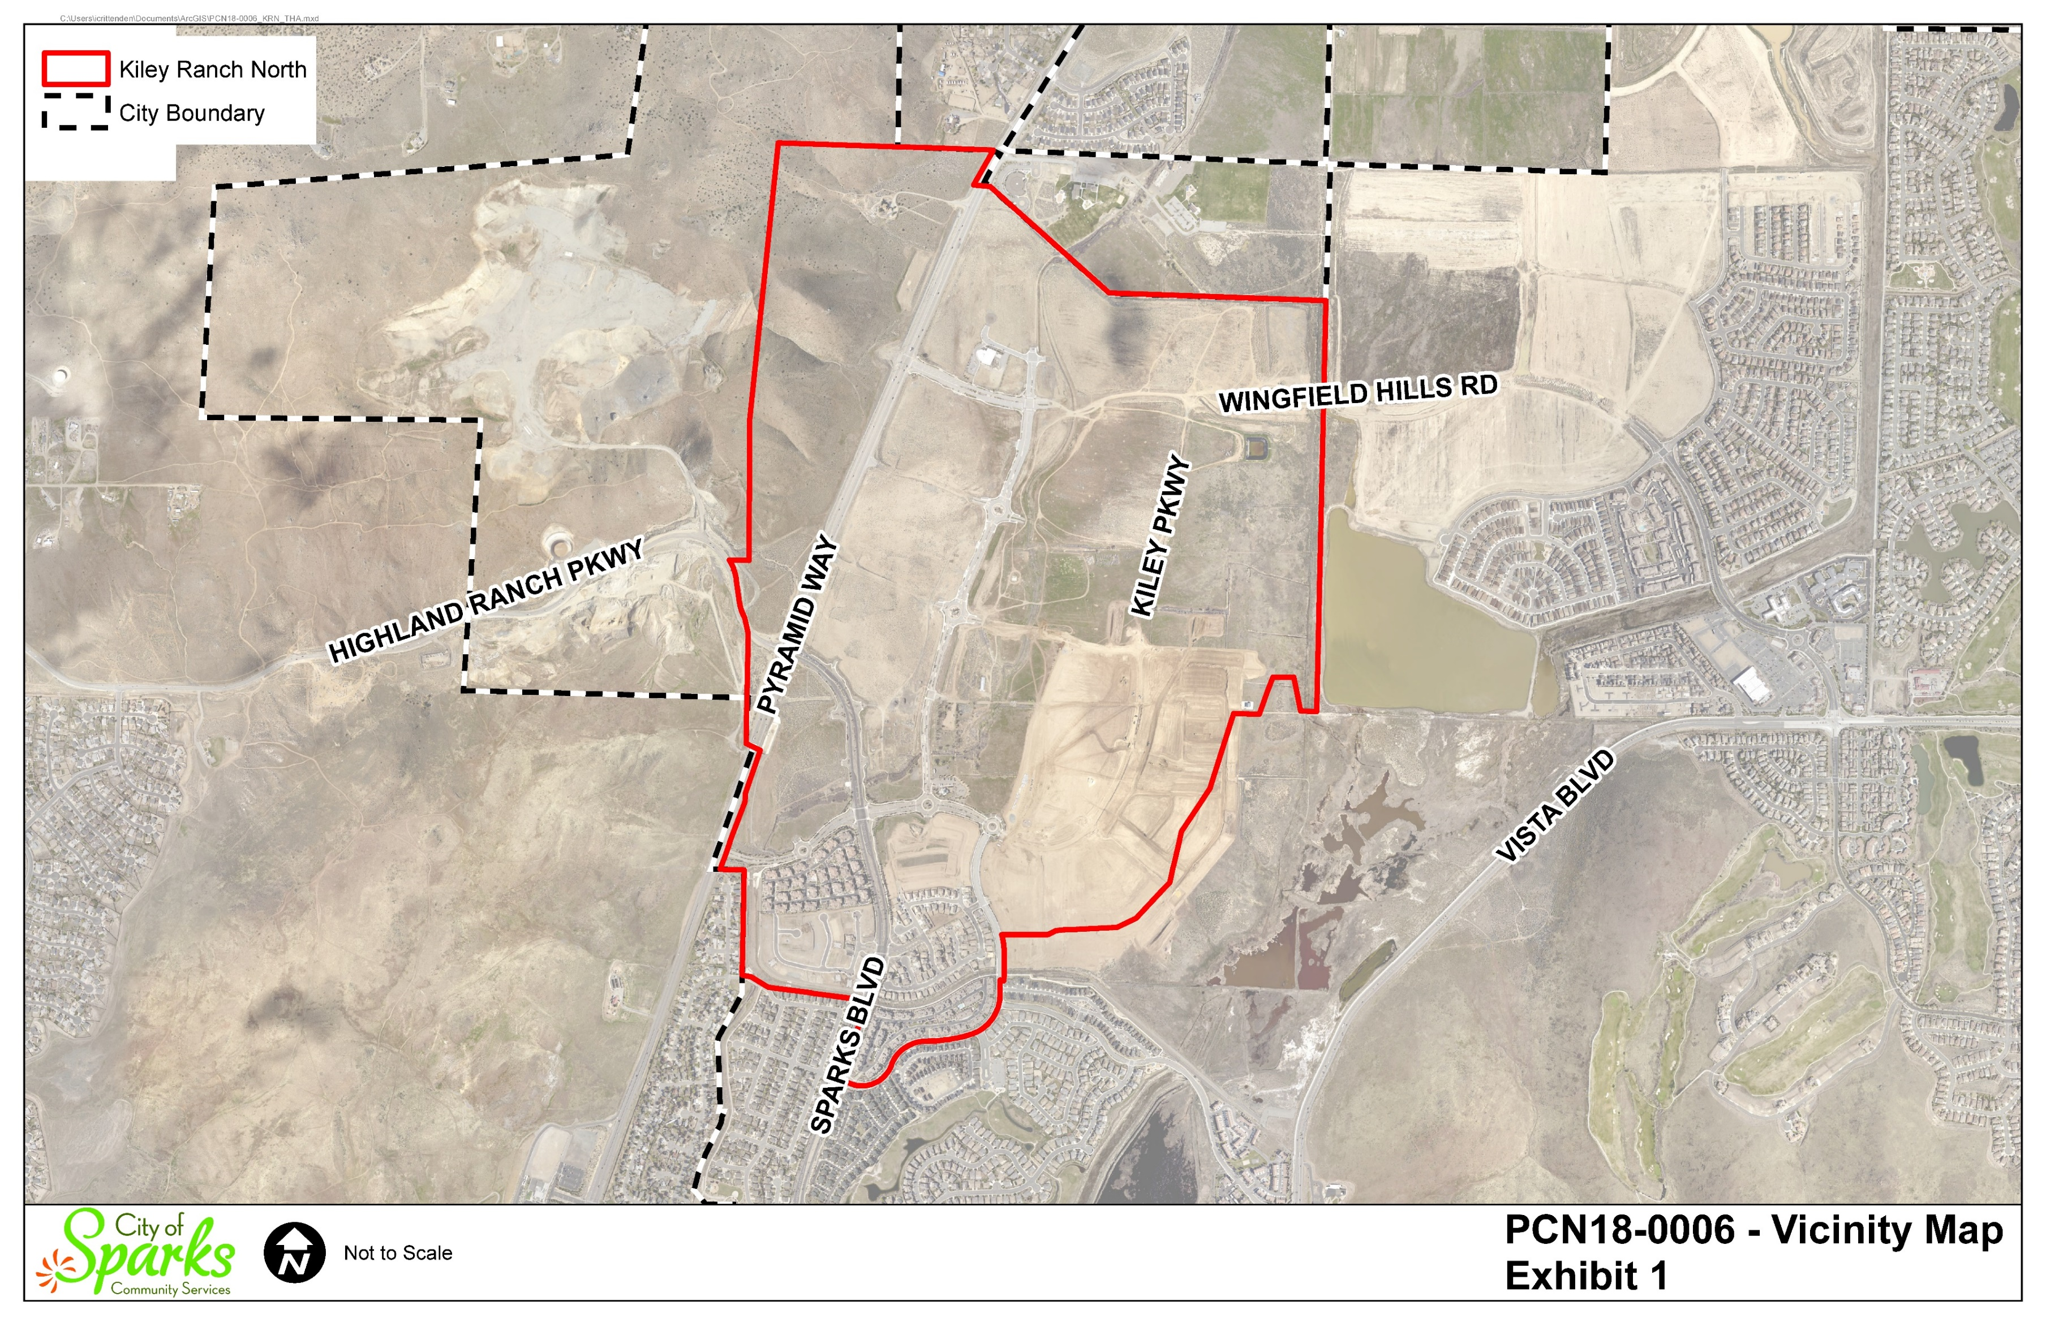

Slide 3
BACKGROUND
2004 – Original tentative handbook approved
2016 – Tentative handbook amendment approved
January 2019 – Comprehensive Plan amendment for KRN certified by City Council

Slide 4
PROPOSED CHANGES TO APPROVED TENTATIVE HANDBOOK
Land Use Map
Floor Area Ratios (FAR)
Add Warehousing and Distribution as a permitted use in Business Park designation
Update the street network and infrastructure maps

Slide 5
LAND USE

Slide 6
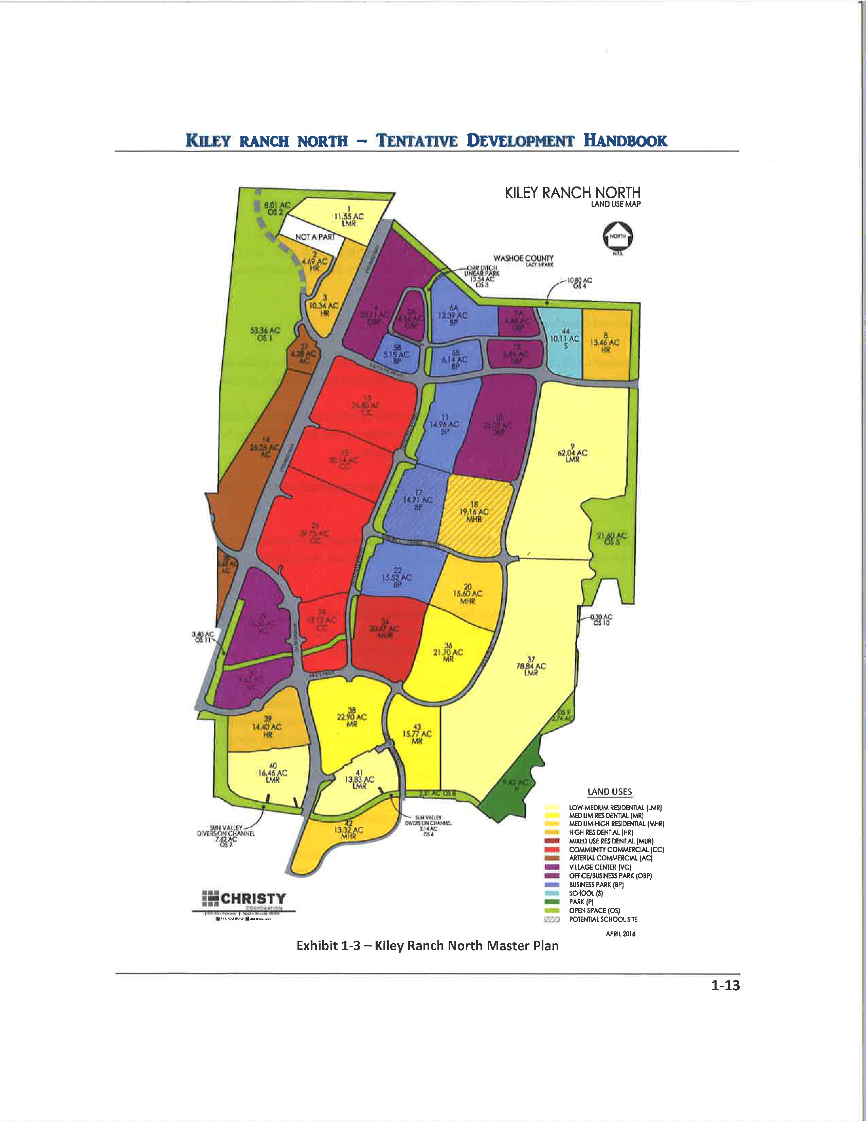
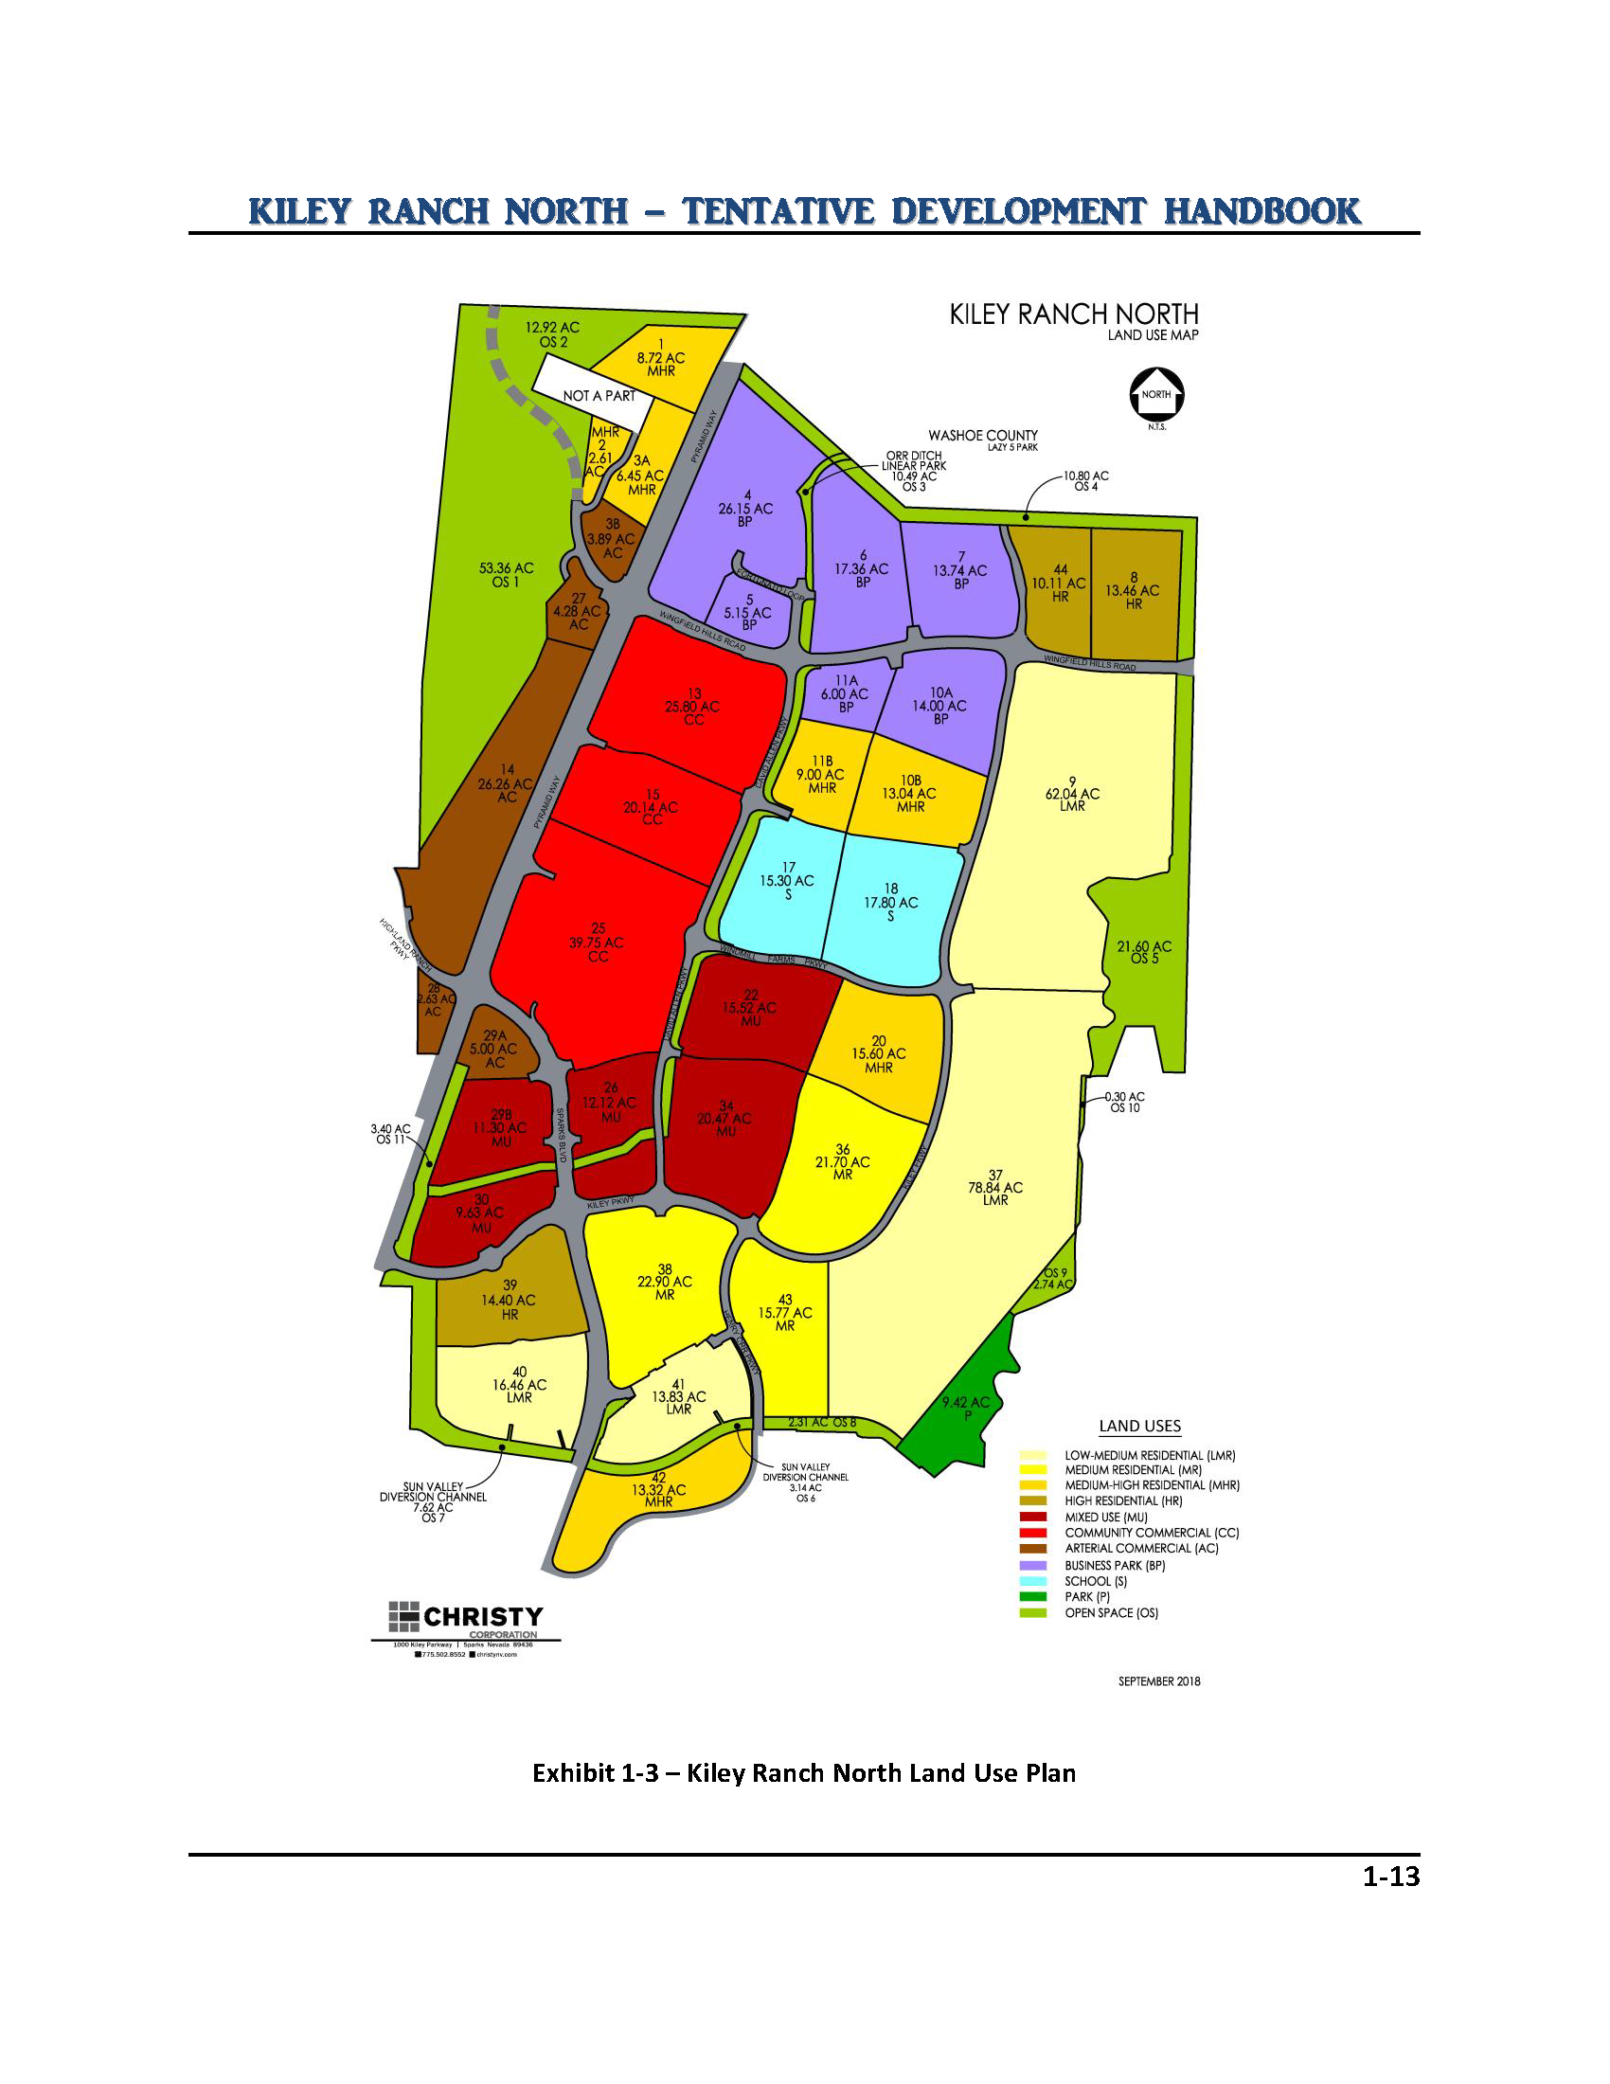
Approved Land Use Plan
Proposed Land Use Plan

Slide 7
Land Use Designation |  | Approved Land Use Designation (gross acres) | Proposed Land Use Designation (gross acres) | Change (gross acres)
Residential Uses
Low Medium Residential (4.0 to 7.9 du/ac) | LMR | 182.7 | 171.2 | -11.5 (-6.3%)
Medium Residential (6.0 to 11.9 du/ac) | MR | 60.37 | 60.37 | 0
Medium-High (12 to 17.9 du/ac) | MHR | 48.08 | 68.74 | 20.66 (42.3%)
High (18 to 23.9 du/ac) | HR | 42.89 | 37.97 | -4.9 (-11.4%)
Mixed Use (5.0 to 23.9 du/ac) | MU | 20.47 | 36.45 | 15.98 (78%)
Total Residential |  | 354.5 | 374.7 | 20.17 (5.7%)

Slide 9
Land Use Designation |  | Approved Land Use Designation (gross acres) | Proposed Land Use Designation (gross acres) | Change (gross acres)
Non-Residential Uses
Mixed-Use (formerly Village Center) | MU | 25.93 | 32.59 | 6.66 (25.7%)
Arterial Commercial | AC | 33.17 | 42.06 | 8.89 (26.8%)
Community Commercial | CC | 97.81 | 85.69 | -12.1 (-12.4%)
Business Park | BP | 128.9 | 82.4 | -46.5 (-36.1%)
Notes:
EPS conclusion is that density is important to improving the City’s fiscal health. As discussed in the staff report there are decreases in acreage in the LMR and HR, there are increases in MHR and Mixed Use. With the maximum number of units at 4,463, staff calculates the changes result in residential densities increasing, in aggregate, by 11.3 to 11.9 percent for the combined four residential land uses. The non-residential uses proposed minimum FARs do not exceed the typical development in Washoe County, however the minimum average FARs impose a FAR to ensure minimum nonresidential density. Discussed in more detail later in this presentation.

Slide 10
Land Use Designation |  | Approved Land Use Designation (gross acres) | Proposed Land Use Designation (gross acres) | Change (gross acres)
Non-Residential Uses
School | S | 10.11 | 33.1 | 22.99 (227.4%)
Park | P | 9.42 | 9.42 | 0
Open Space | OS | 126.82 | 128.68 | 1.86 (1.4%)
Subtotal Non-Residential |  | 432.18 | 413.94 | -18.2 ac (-4.2%)
Roadways |  | 87.5 | 85.57 | --
Project Totals |  | 874.21 | 874.21 | 0

Slide 11
FLOOR AREA RATIO

Slide 12
Non-Residential Land Use Designation |  | Approved Tentative Handbook Maximum FAR | Proposed Tentative Handbook Minimum FAR
Arterial Commercial | AC | 0.25 (33.17 acres) | 0.2 (42.05 acres)
Community Commercial | CC | 0.25 (58.06 acres) | 0.25 (85.69 acres)
Community Commercial – Medical Campus | CC | 0.85 (39.75 acres) | Part of CC
Mixed Use (Formerly Village Center) | MU | 0.25 (25.93 acres) | 0.2 (32.59 acres)
Business Park | BP | 0.5 (68.87 acres) | 0.3 (82.4 acres)
Office/Business Park | OBP | 0.2 (60.05 acres) | Removed Land Use as part of CPA

Slide 13
ADDITION OF WAREHOUSING AND DISTRIBUTION USE (IN BUSINESS PARK LAND USE DESIGNATION)
Maximum 200,000 square feet building size
Staff supports based on EPS fiscal analysis
Permissive versus Prescriptive

Slide 14
FISCAL IMPACT ANALYSIS (FIA)
Applicant’s analysis projects fiscal impact is positive by approximately $10.8 million over 20-year analysis period
General Fund revenue - $35.9 million
Road Fund deficit – -$25.1 million

Slide 15
JOB-TO-HOUSING BALANCE

Slide 16
PLANNED DEVELOPMENT FINDINGS

Slide 17
Finding PDa –Consistency with statement of objectives in planned unit development.
Proposed amendments consistent with objectives of providing open space, a variety of housing types, and a mix of land uses.

Slide 18
Finding PDb – Whether changes to zoning regulations are in the public interest
Proposed densities within range of densities permitted by Title 20
Not all non-residential uses permitted by Title 20 are permitted by KRN handbook
Maximum building height of 170 feet tall is higher than permitted by Title 20 (with exception of downtown)

Slide 19
Finding PDc – Ratio of residential to nonresidential uses
NOTE: Approx. 10% for Streets

Slide 20
Finding PDd – Adequacy of common open space
The combination of open space, future streetscape, trail network and project landscaping results in compliance with the 20% open space requirement.
Maintenance

Slide 21
Finding PDe – Adequacy of public services and utilities, traffic control, and light, air, recreation and visual enjoyment
Infrastructure plan updated
Provides design standards ensuring access to light, air, recreation and visual enjoyment with community park and trail network

Slide 22
Finding PDf – Relationship of the planned unit development to the surrounding area
One of largest planned developments in Sparks and important to community’s future
Variety of housing options, retail and services (including medical), and employment opportunities

Slide 23
Finding PDg – Protecting the integrity of the plan
Retains large majority of land uses and development standards
Standards regulate character and development quality
Provides for community facilities and utilities

Slide 24
RECOMMENDATION:
Staff and Planning Commission believes all 7 findings can be made and recommends approval of the proposed amendments to the Tentative Handbook for the Kiley Ranch North Planned Development.

Slide 25
RECOMMENDED MOTION:
I move to approve the amendments to the Tentative Development Handbook for the Kiley Ranch North Planned Development associated with PCN18-0006, adopting Findings PDa through PDg and the facts supporting those findings as set forth in the staff report.

